Slide 1

Blood Bank Management System
Prepared By :- Gopal Krishn, Harshada Girase
Supervised By :- Swati Bhat

Slide 2
INTRODUCTION:-
The Main objective of the Blood Bank Management System is to manage the details of Blood, Donor, Blood Group, Blood Bank, Stock and maintain the buyer .
The Project is totally built at administrative end and thus only the administrator is guaranteed the access.
The purpose of the project is to build an application program to reduce the manual work for managing the Blood, Donor, and also sell the blood packet.
It track all the details about buyer and Blood Bank, Stock

Slide 3


Overview
The Blood Management System is an innovative solution that helps in managing huge loads of blood bank data. It keep track of donor, available blood plackets. The Blood Bank management system simplifies the manual work and allows smooth administration of the operations of blood related information. The System is sell the blood packets and maintain the information of buyers.

Slide 4
Problem Statement:-
Each time a blood donation campaign being held, the staff will have a time to retrieve back the person record. The staff need to manually search for the person record.They need to go through all the medical record one-by-one until they find the person record that they been searching for. This process will be time consuming and ineffective.

Slide 5
System Flow Diagram:-
By Packet No.
Main UI
By Blood Group
New Donor
By Name
Search Donor
By Date
Sell Blood
Search Buyer
By Name
Packets
By Packet No

Slide 6
Scope:-
It may help collecting perfect management in details. In a very short time, the collection will be obvious, simple and sensible.
It will help a person to know the management of passed year perfectly and vividly.
It also helps in currently all works relative to Blood Management System.
It will be also helps to reduced the cost of collecting the management & collection procedure will go on smoothly.

Slide 7






Modules & Functionality
Modules of Blood Bank Management System :-
New Donor :- Used for managing the donor details.
Search Donor :- Search information about Donor.
Sell Blood :- Module for Sell the Blood packet to the Buyer
Search Buyer :- Search the information of buyer.
Blood Packet Available :- Maintain the Blood information, Stock

Slide 8
Functionality provided by System :-
Provides the searching facilities based on various factors. Such as Donor, Buyer, Blood Stock.
Blood Bank Management System also manage the Record details for Blood stock, Donor and Buyer.
It tracks all the information of Blood Group, Donor Records etc.
Integration of all records of Blood.

Slide 9

Software Requirements :-
Software Requirements
Operating System | Windows 10
Language | Java 2 Runtime Environment
Database | MySQL Server,
Web Server | Xammp
Software Development Kit | Java JDK 1.7 or Above
Database JDBC Driver | MySQL Jconnector

Slide 10
Hardware Requirement :-
Processor | Intel i³
RAM | 8 GB
Hard Disk | 500 GB
Monitor | 15” colour monitor
Keyboard | 122 keys

Slide 11
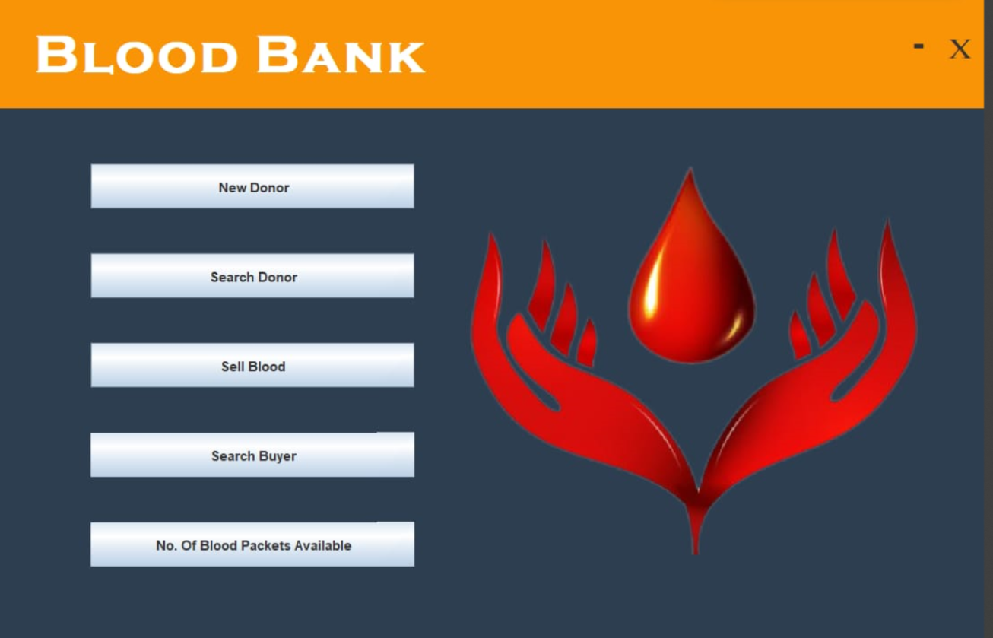
User Interface:-
This is the homepage of the software where you use features, options and etc.

Slide 12
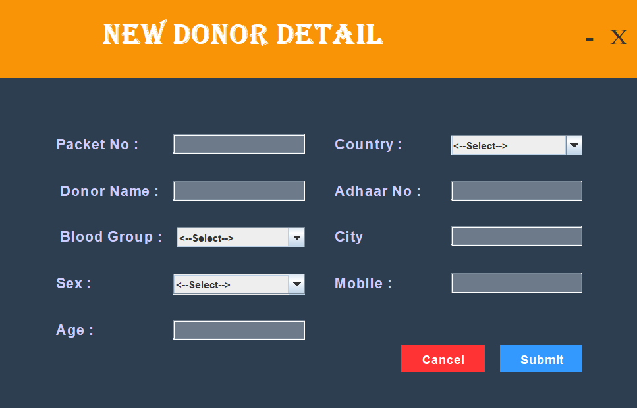
New Donor Details: This module store the details of donor

Slide 13
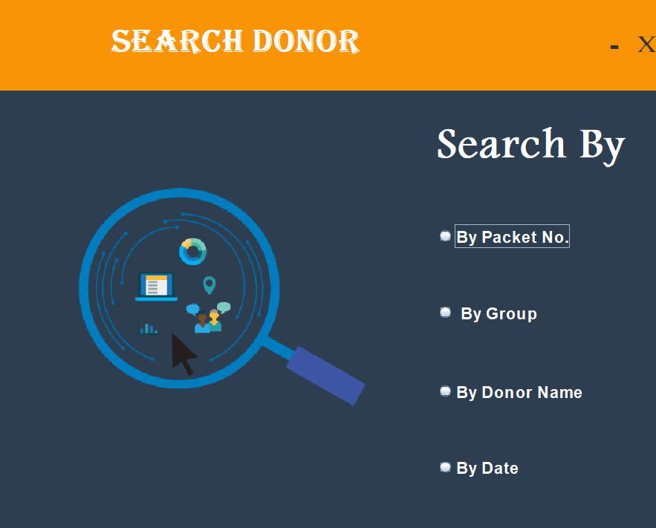
Search Donor:- Search donor information on the based of various factor
2024

Slide 14
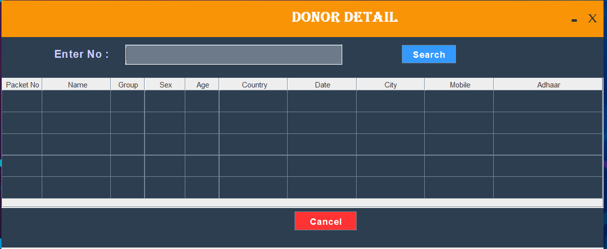
Donor Details:- Display the information of domain
2024

Slide 15
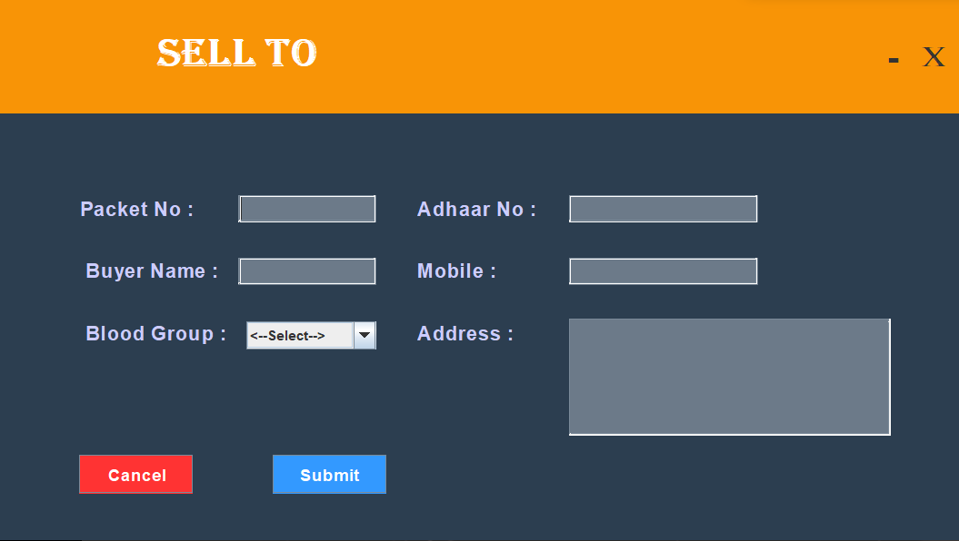
Sell To :- Store the details of buyer information
2024

Slide 16
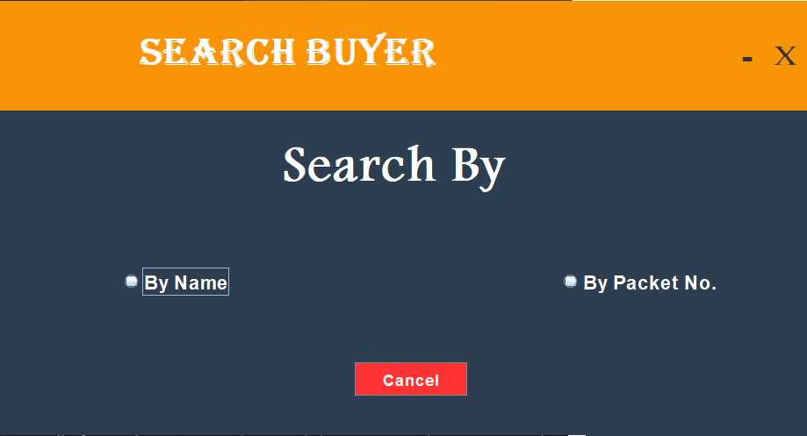
Search Buyer :- Search buyer details based on the name and packet number.
2024

Slide 17
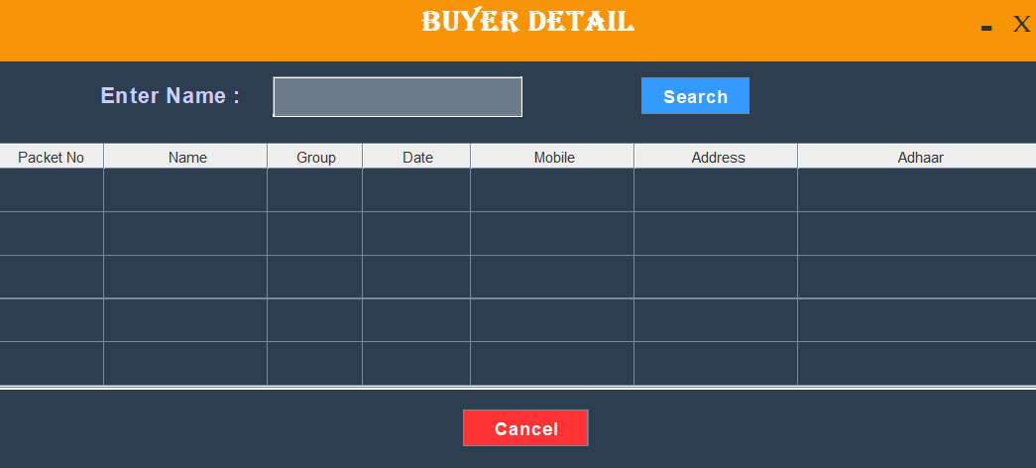

Buyer Detail:- shows the buyer details based on the name and packet number.
2024

Slide 18
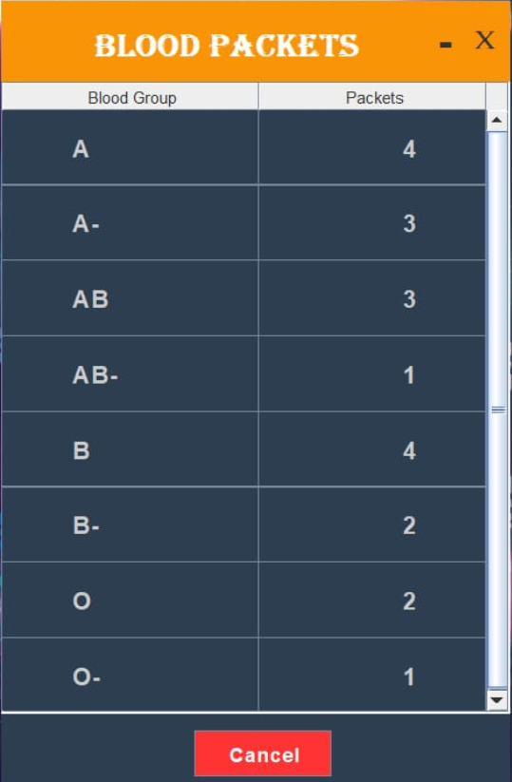
Blood Packets :- Shows the available blood packets
2024

Slide 19


Data Tables

Slide 20
Donor table:-
SR. No | Column Name | Type | Size | Description
1. | Packet_No | Int | 255 | Primary Key
2. | Donor_Name | Varchar | 50 | -
3. | Country | Varchar | 50 | -
4. | Adhaar_NO | BigInt | 20 | Unique
5. | Date | Date | - | CurrentTimeStamp
6. | BloodGroup | Varchar | 20 | -
7. | City | Varchar | 50 | -
8. | Gender | Varchar | 20 | -
9. | Mobile_No | Bigint | 20 | -
10. | Age | Int | 255 | -

Slide 21
Buyer Table:-
SR. No | Column Name | Type | Size | Description
1. | Packet_No | int | 255 | Primary Key
2. | Buyer_Name | varchar | 50 | -
3. | Mobile_No | Bigint | 20 | -
4. | Adhaar_NO | BigInt | 20 | Unique
5. | Date | date | - | CurrentTimeStamp
6. | BloodGroup | varchar | 20 | -
7. | Address | varchar | 50 | -
10. | Age | int | 255 | -

Slide 22
Blood Packet Table:-
Sr. | Column Name | Type | Size | Description
1. | Packets | int | 255 | Primary Key
2. | Blood_Group | String | 15 | -

Slide 23
Limitations:-
The Transactions are executed in off-line mode, hence online data for Donor, Blood Stock capture and modification is not possible.
off-line reports of Blood Bank, Donor cannot be generated due to batch mode execution.

Slide 24

Future Enhancement:-
We can give more advance software for
Blood Bank Management System including more facilities.
Implement the backup mechanism for taking backup of codebases and database on regular basis.

Slide 25
Conclusion:-
At the end it is concluded that we have made effort on following points…
A description of the background and context of the project and its relation to work already done in the area.
Made statement of the aims and objectives of the project.
The description of Purpose, Scope, and applicability.
We define the problem on which we are working in the project.
We understand the problem domain and produce a model of the system, which describes operations that can be performed on the system.
We designed the User Interface and security issues related to the system.

Slide 26

Thank You!

